Slide 1
Malignant Pleural Mesothelioma: An Overview
Ankit Gupta MD, Homam Alkaied MD,
Kassem Harris MD

Slide 2
Malignant Pleural Mesothelioma Introduction
Malignant pleural mesothelioma (MPM), is a rare cancer originating from the parietal pleura:
0.1-0.6 cases/10 millions in China
20 cases/million in Germany
8 cases/million in Japan
10 cases/million in USA
Affects elderly patients, F>M
Incidence increasing and expected to peak in 2020
Diagnosed at locally advanced or metastatic stages in most patients.
Risk Factors:
Occupational asbestos exposure
Simian virus 40 (SV40), erionite, prior radiation, zeolite, fiberglass, and other chemicals
Genetic predisposition (autosomal dominant, genetic susceptibility)
Collapsotherapy (induction of pneumothorax to treat tuberculosis)
Ann Cardiothorac Surg 2012;1(4):491-496
Lancet. 2001 Feb 10;357(9254):444-5.
Eur Respir Rev 2016; 25: 472–486

Slide 3
Malignant Pleural Mesothelioma EPIDEMIOLOGY
Mesothelioma is an insidious neoplasm because of its long latency period—up to 40
years in some series
Peak incidence occurs in the 5th and 6th decades of life
Majority of asbestos fibers are either amphibole or serpentine
The serpentine fibers make up most of the type seen in the US and are
less carcinogenic than the amphibole type.
Found in brake linings, ship building, cement, and ceiling and pool tiles
The Ochsner Journal 12:70–79, 2012

Slide 4
Malignant Pleural Mesothelioma PATHOGENESIS
Clinical manifestations:
Chest pain, dyspnea, cough, fever, night sweats, and weight loss
Pathogenesis:
Asbestos is inhaled into the lungs
Forms oxided iron bodies, doesn’t get swallowed by the macrophages, causing a reactive hyperplasia of multinucleated marcrophages
Uncontrolled proliferation resulting in mutation of mesothelial cells and cancerization
Natural killer (NK) cells activity is inhibited by asbestos
Ann Transl Med 2015;3(13):182

Slide 5
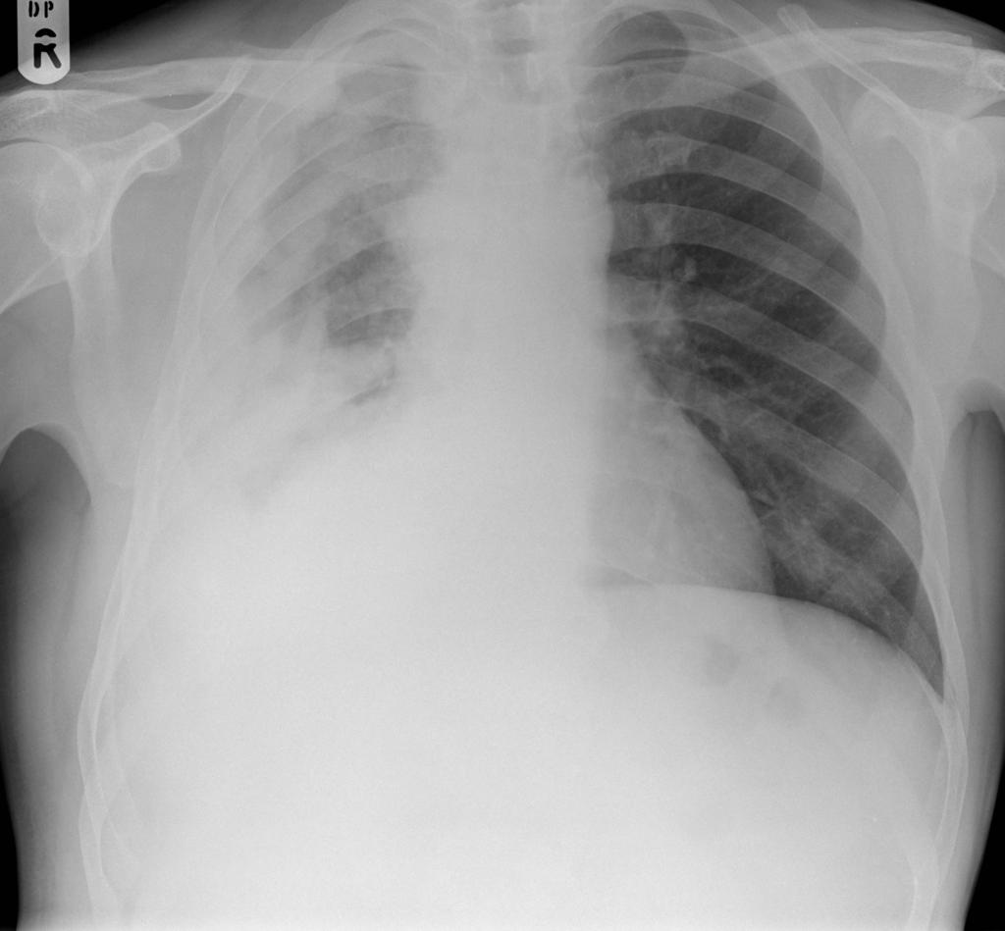
Malignant Pleural Mesothelioma CXR
Courtesy of Dr Ian Bickle, Radiopaedia.org, rID: 30112
Value of Chest X-Ray:
Pleural effusion
Pleural thickenning/mass
Unable to assess MPM
Circumferential pleural thickening in the right thoracic cavity, with volume loss
Eibel R et al, COPM 2003;15: 131-8
Scherpereel A (SPLF), RM 2007;101: 1265-76

Slide 6
Malignant Pleural Mesothelioma CT Chest
Courtesy of Dr Ahmed Abdrabou, Radiopaedia.org, rID: 22607
Value of CT scans:
Pleural thickenning, tumors, effusion, plaques
Assessement of MPM
Circumferential nodular right pleural thickening involving the fissures and associated with volume loss
Eibel R et al, COPM 2003;15: 131-8
Scherpereel A (SPLF), RM 2007;101: 1265-76

Slide 7
Malignant Pleural Mesothelioma Pathology of MPM
Malignant Pleural Mesothelioma:
Epithelial: 50-70%, good prognosis
Sarcomatoid:7-20%, poor prognosis,
Biphasic: 20-35%, intermediate prognosis,
Benign mesothelioma:
Benign multicystic mesothelioma: large grape-like cystic clusters, usually peritoneal, risk factors: Female and history of endometriosis.
Well-differential papillary mesothelioma: usually asymptomatic and peritoneal. Mostly cured by surgery.
Chest 2009 Volume 136, Issue 3, Pages 888–896
Environ Health Prev Med 2008 Mar; 13(2): 60–64

Slide 8
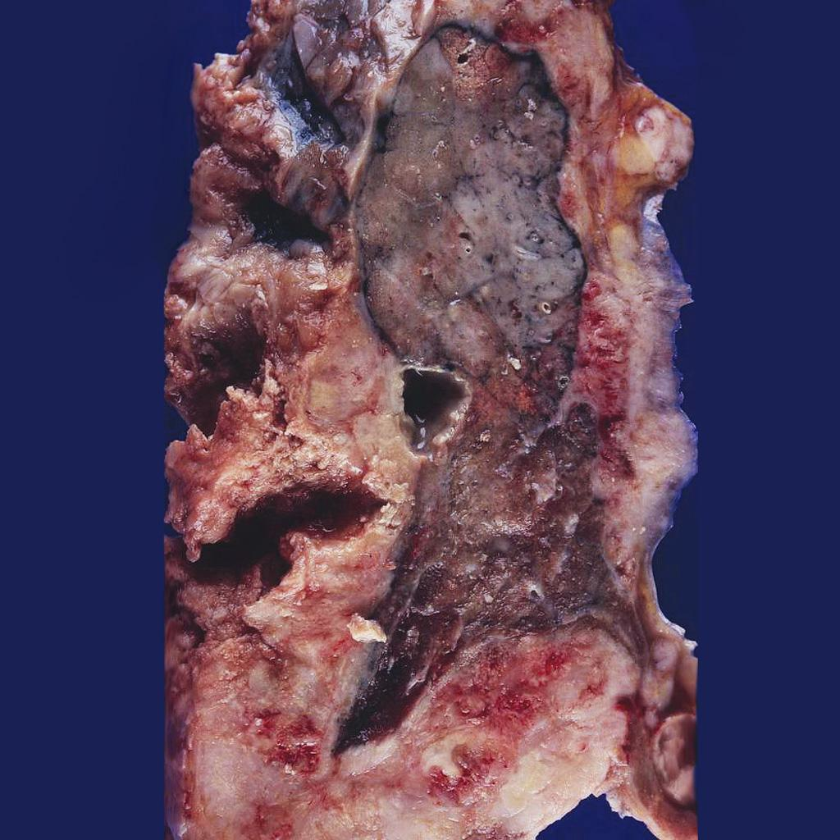
Malignant Pleural Mesothelioma Pathology
Mesothelioma encasing the lung
Courtesy of Dr Yale Rosen, Radiopaedia.org, rID: 8699

Slide 9
Malignant Pleural Mesothelioma Diagnostic Methods
Pleural fluid cytology: 26% diagnostic yield
Close pleural biopsy: 21% diagnostic yield
Pleural fluid cytology + Close pleural biopsy: 39% diagnostic yield
Medical thoracoscopy: 98% diagnostic yield
Forceps biopsy of the parietal pleura during medical thoracoscopy
Cancer. 1993 Jul 15;72(2):389-93.

Slide 10
Malignant Pleural Mesothelioma Diagnostic Methods
US Guided thoracentesis : First test in MPM presenting with a pleural effusion.
low yield overall
Thoracoscopy with multiple pleural biopsies, ideally from several locations
in the ipsilateral hemithorax. Very high yield
Nodular pleural thickening without a pleural effusion: CT guided core biopsy of
pleural-based masses can be used
Open pleural biopsy can also be considered for these patients, and for those
without an effusion or a patent pleural space to allow for safe thoracoscopy
J Clin Oncol. 2018 Jan 18
Cancer. 1993 Jul 15;72(2):389-93
Eur J Cardiothorac Surg 16:619-623, 1999
Lancet 361: 1326-1330, 2003

Slide 11
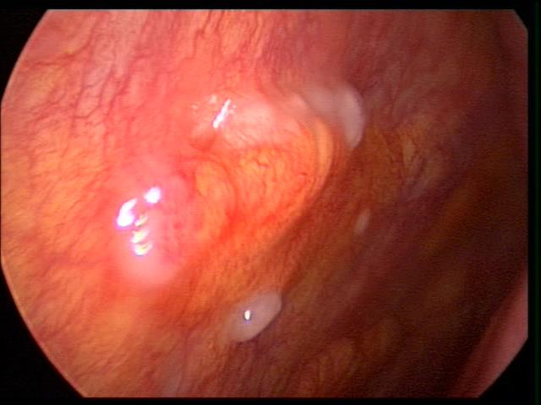
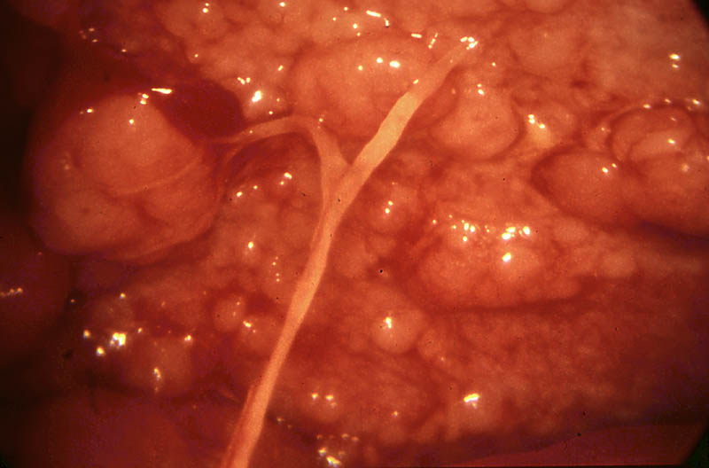
Malignant Pleural Mesothelioma Diagnostic Methods
Thoracoscopy
Early nodular mesothelioma
Extensive nodular mesothelioma
Mesothelioma pachypleuritis

Slide 12
Malignant Pleural Mesothelioma IMMUNO-HISTOCHEMISTRY
Positive markers: Calretinin, keratins 5/6, Wilms tumor protein 1 (WT1), and
podoplanin.
Negative markers (positive in adenocarcinoma) :Carcinoembryonic antigen (CEA),
epithelial cell adhesion molecule (EPCAM),blood group 8, and Claudin 4, napsin A
and thyroid transcription factor 1 (TTF-1).
J Clin Oncol. 2018 Jan 18
Arch Pathol Lab Med 137:647-667, 2013

Slide 13
Malignant Pleural Mesothelioma Staging
Used to guide treatment and to predict survival.
Many patients with malignant mesothelioma are locally advanced or metastatic at the time of diagnosis.
Patients may be upstaged during surgery
PET/CT scan to evaluate the disease extension may be performed before surgery.
J Clin Oncol. 2018 Jan 18
Eur Respir Rev Oct 2016

Slide 14
Malignant pleural mesothelioma TNM staging AJCC 2017

Slide 15
Malignant Pleural Mesothelioma STAGING
Initial test: CT scan of the chest and upper abdomen with IV contrast
If abdominal metastasis is suspected : abdominal ±pelvis CT scan, with IV and oral contrast
MRI IV contrast may be used for invasion of the tumor into the diaphragm, chest wall and mediastinum
FDG PET/CT can be performed in patients with stage 1 to 3 with epithelial histology to evaluate for N2 involvement. Degree of FDG uptake can have prognostic implications
J Clin Oncol. 2018 Jan 18
Cardiovasc Thorac Surg 12:806-811, 2011

Slide 16
Malignant Pleural Mesothelioma STAGING
MPM can metastasizes to mediastinal lymph nodes.
For patients being considered for surgical cytoreduction, a mediastinoscopy
and/or EBUS/EUS may be considered if nodes are visible on imaging
Ann Thorac Surg 88:862-868, 2009
Ann Thorac Surg 80:1988-1992, 2005
J Clin Oncol. 2018 Jan 18

Slide 17
Malignant Pleural Mesothelioma CHEMOTHERAPY
Chemotherapy improves survival and QoL in treated patients
Selected patients with a poor performance status may be offered a single-agent Chemotherapy, or palliative care alone
For patients who are not candidates for surgery, the ﬁrst-line treatment could be chemotherapy with pemetrexed and platinum + VGEF inhibitor with bevacizumab
J Clin Oncol. 2018 Jan 18
J Clin Oncol 21: 2636-2644, 2003

Slide 18
Malignant Pleural Mesothelioma SURGERY
Used for early stage disease and in patients with good functional status
For early stage disease maximal surgical cytoreduction may be considered
No RCTs comparing surgery for early stage MPM to chemotherapy are available
Following surgical resection, adjuvant chemotherapy and/or radiation
therapy is usually offered to decrease the likelihood of local recurrence. Some patients are offered neoadjuvant chemotherapy.
Maximal surgical cytoreduction involves either extrapleural pneumonectomy
or lung-sparing options (pleurectomy/decortication)
J Clin Oncol. 2018 Jan 18
JThoracCardiovascSurg122: 788-795, 2001
Eur Respir Rev Oct 2016

Slide 19
Malignant Pleural Mesothelioma PLEURAL EFFUSIONS
Tunneled pleural catheters(TPCs) may be avoided in patients who are candidates for
maximal surgical cytoreduction, because of the risk of tumor implantation into the
chest wall
TPCs/ pleurodesis/VATS decortication may be offered in symptomatic patients with
effusions with poor functional status where maximal cytoreduction is not feasible
for palliation
Chest 146:557-562, 2014
J Clin Oncol. 2018 Jan 18

Slide 20
Malignant Pleural Mesothelioma RADIATION THERAPY
Radiation therapy can be utilized to palliate symptoms
It may be offered to patients with localized asymptomatic recurrence
Prophylactic irradiation of intervention tracts (TPCs/biopsies etc.) is not usually recommended
J Clin Oncol. 2018 Jan 18
J Thorac Oncol 10:944-950, 2015

Slide 21
Malignant Pleural Mesothelioma PALLIATIVE CARE
Recommended early on by all major pulmonary societies
Depression should be recognized and treated
Goal is to maintain a good quality of life
Thorax 2007; 62: Suppl 2, ii1–ii19
Eur Respir J 2010; 35: 479–495

Slide 22
Malignant Pleural Mesothelioma PROGNOSIS
Overall survival is 9 to 17 months after diagnosis
Local invasion and respiratory failure are among the causes of death
Sarcomatoid and biphasic histologic subtypes have worse outcomes compared
with epithelioid mesothelioma
Advanced age and poor performance status are other poor predictors of outcome
J Clin Oncol. 2009;27:3007

Slide 23
Malignant Pleural Mesothelioma Knowledge Assessment
Question 1: A 68 year old male who worked in the ship building industry for 30 years presents
to your office with progressive shortness of breath , weight loss and malaise. He is
hemodynamically stable with an O2 saturation of 93% on room air. A CXR shows a
pleural based mass and a moderate size right sided pleural effusion . Based on the
presentation , MPM is suspected . What is the next step to establish the diagnosis?

Slide 24
Malignant Pleural Mesothelioma Knowledge Assessment
Answer 1 : Ultrasound-guided thoracentesis can be the first diagnostic test and pleural ﬂuid should be sent for cytologic examination for initial assessment for possible mesothelioma . The diagnostic yield is low
Thoracoscopic pleural biopsy is the gold standard diagnostic test.

Slide 25
Malignant Pleural Mesothelioma Knowledge Assessment
Question 2:
A patient with MPM was deemed a candidate for surgical resection. Waiting for his surgery, the pleural fluid reaccumated within a few days and he became dyspneic.
What would be the next stem in the management of the recurrent pleural effusion?

Slide 26
Malignant Pleural Mesothelioma Knowledge Assessment
Answer 2:
Thoracentesis should be the best next step giving that the patient is symptomatic.
TPCs are not usually recommended for patients who are candidates for surgical cytoreduction due to risk of tumor seeding into the chest wall .
TPCs may be useful in patients who are not candidates for surgical resection and for palliation of symptoms.

Slide 27
This presentation was prepared by
Authors:
Ankit Gupta MD, Hartford Healthcare , Norwich Connecticut
Homam Alkaied MD, St. Lukes, Duluth Minnesota
Kassem Harris MD, Westchester Medical Center, Valhalla NY
and reviewed for accuracy and content by members of the
WABIP Rare Lung, Pleura and Airway Disorders section

